Slide 1
Employee Data Analysis using Excel
STUDENT NAME: R.Keerthana
REGISTER NO : 122200083
DEPARTMENT: B.COM (CS) IIIYR
COLLEG : PACHAIYAPPAS COLLEGE FOR WOMEN

Slide 2
PROJECT TITLE
Visualizing Employee Attendance
Trends With Excel Chart

Slide 3


AGENDA
Problem Statement
Project Overview
End Users
Our Solution and Proposition
Dataset Description
Modelling Approach
Results and Discussion
Conclusion
3/21/2024 Annual Review

Slide 4

PROBLEM STATEMENT
This section would likely define the specific issue related to employee attendance that the project aims to address. For example, it might discuss challenges such as absenteeism, tardiness, or unauthorized absences.

Slide 5

PROJECT OVERVIEW
.
This section would provide a general overview of the project, including its goals, objectives, and scope. It might also outline the methodology and approach that will be used to address the problem.

Slide 6


WHO ARE THE END USERS?
This section would identify the target audience for the project, which could include employees, managers, or human resources personnel. Understanding the end users will help tailor the solution to their specific needs.

Slide 7

OUR SOLUTION AND ITS VALUE PROPOSITION
This section would present the proposed solution to the employee attendance problem. It might involve introducing new policies, implementing tracking systems, or providing incentives for regular attendance.

Slide 8
Dataset Description
This section would describe the data that will be used in the project. It might include information about the sources of the data, the types of data collected, and the time period covered.

Slide 9

THE "WOW" IN OUR SOLUTION
1. Conditional formatting: Highlight trends, anomalies, or key insights with colors, icons, or data bars.
2. Dynamic dashboards: Create interactive dashboards with slicers, timelines, and filters for real-time analysis.
3. Drill-down capabilities: Enable users to drill down into detailed data with a simple double-click.
4. Custom calculations: Use calculated fields to create unique metrics, like year-over-year growth or moving averages.
3/21/2024 Annual Review
9

Slide 10
MODELLING
This section would explain the statistical or machine learning techniques that will be used to analyze the data. It might discuss the specific models or algorithms that will be employed.
10

Slide 11
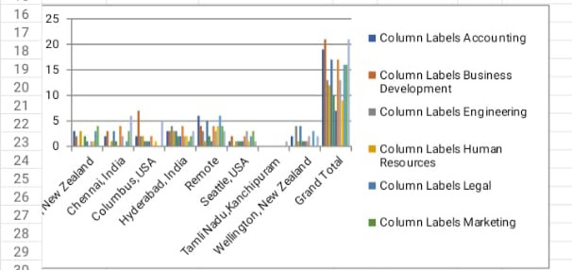
RESULTS
11

Slide 12
conclusion
This section would summarize the key findings of the project and reiterate the main conclusions. It might also provide recommendations for future action or research. Overall, the image suggests that the project will involve analyzing employee attendance data to identify patterns, trends, and potential solutions.

